Slide 1
Protecting Your Data:
Aware and Prepared
Learn how to spot and avoid scams
46754.4
Notes:
Hello! My name is [name and title]. Welcome to our session, Protecting Your Data: Aware and Prepared.
The end goal for most scammers is some sort of financial gain. So that’s why your financial advisor or investment professional is hosting this seminar: They want to help you limit risk in your financial life, and cyber security and awareness is a piece of that. Your personal data in the wrong hands can be used to throw off the financial plan that you’ve worked so hard for.

Slide 2
MFS® does not provide cyber security advice. The information contained within this material is for awareness purposes only, given the rapid pace of change in technology, the digital world and cyber threats.
Third-party websites and applications are not affiliated with MFS, and MFS is not responsible for their content or content changes, or for any negative effect of software installations on client’s devices, misuse of data collected by any third-party services, or changes in the quality of services.
MFS does not provide legal, tax or accounting advice. Clients of MFS should obtain their own independent tax and legal advice based on their particular circumstances.
You should recommend products based on your client's financial needs, goals, and risk tolerance. The views expressed in this presentation are those of MFS and are subject to change at any time. These views should not be relied upon as investment advice, as securities recommendations, or as an indication of trading intent on behalf of any other MFS investment product. No forecasts can be guaranteed.
MFS Fund Distributors, Inc. may have sponsored this seminar by paying for all or a portion of the associated costs. Such sponsorship may create a conflict of interest to the extent that the broker dealer's financial advisor considers the sponsorship when rendering advice to customers.
"Issued in the United States by MFS Institutional Advisors, Inc. (“MFSI”) and MFS Investment Management. Issued in Latin America by MFS International Ltd"
MFS Fund Distributors, Inc., Boston, MA

Slide 3
Agenda
What you need to know
Types of threats and attacks
Prevention tips and ways
to fight back
Actions to take
if scammed
Direct
Digital
Hybrid
Notes:
So today, we're going to talk about:
the major threats out there,
proactive ways to protect yourself and your loved ones
finally, steps you can take if you become a victim
Now, for our conversation, we’ve divided the threats into three categories: direct, digital and hybrid.
Direct threats exploit physical access. They require little to no technical knowledge.
Digital threats use technology.
And hybrid threats – which are the most common – are a combination of the two. Think of it as a layered attack that involves multiple points of contact.
We’re going to go through the most common direct threats and attacks, then the most common digital ones. Being aware of the threats on an individual level increases the likelihood that you’ll spot a scam as soon as possible and hopefully reduce your chance of becoming a victim.

Slide 4
Direct Threats
Notes:
First up: direct threats

Slide 5
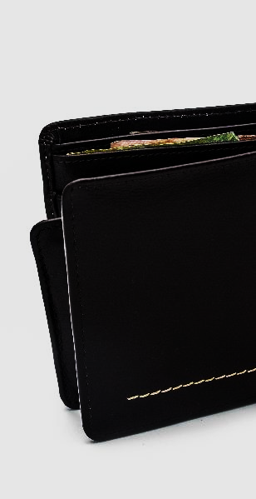
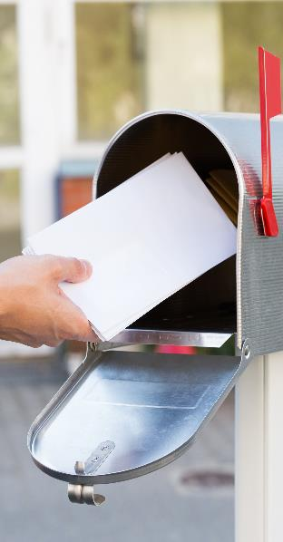
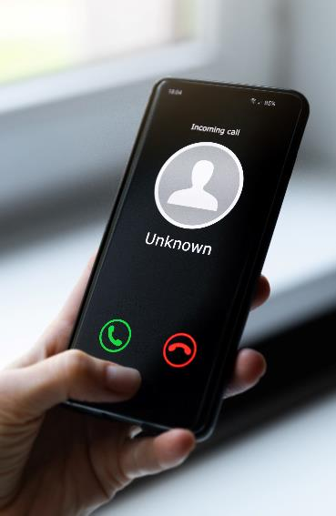
Types of Direct Threats
How to spot and avoid scams
Lost or stolen physical property
Mail scams
Phone calls or voice messages
Notes:
Some of the most common direct threats are: lost or stolen physical property, mail scams and phone calls or voice messages.

Slide 6
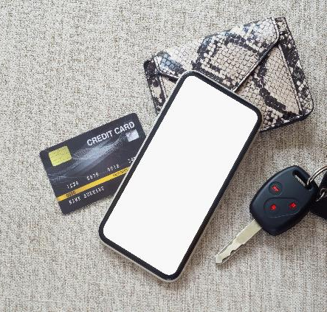
Lost or Stolen Property
SOURCES
PROTECTION
Cash and checkbooks
Driver’s license
Credit and debit cards
Social Security card and health insurance and cards
Keys
Limit what you carry
Store important items in a safe
Use a shredder and go paperless
  optoutprescreen.com
  dmachoice.org
  catalogchoice.org
MFS® does not provide cyber security advice. The information contained within this material is for awareness purposes only, given the rapid pace of change in technology, the digital world and cyber threats. Third-party websites and applications are not affiliated with MFS, and MFS is not responsible for their content or content changes or for any negative effect of software installations on clients’ devices, misuse of data collected by any third-party services, or changes in the quality of services.
Notes:
For lost or stolen property. This includes things like a wallet, purse or unsecured mobile devices. Three things you can do to try to protect yourself:
Only carry what you need daily. Consider radio-frequency identification (RFID)-blocking sleeve, wallet, or bag for extra layer of protection.
Store important items in a safe.
Use a crosscut shredder and go paperless. In addition, there are ways to reduce junk mail. Three resources are: optoutprescreen.com or 1-888-5-OPT-OUT, dmachoice.org, and catalogchoice.org

Slide 7
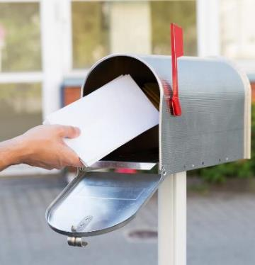
Mail Scams
THREATS
PROTECTION
Mail theft
Requests to “confirm personal information”
Fake checks and money orders
Lottery and prize scams
Reduce junk mail
Use a locked mailbox
Sign up for Informed Delivery through USPS
  Informeddelivery.usps.com
MFS is not affiliated with USPS. These entities/products/links are being provided as a convenience and for informational purposes only; they do not constitute an endorsement or approval by MFS.®
Notes:
The second type of direct threat is (US postal) mail scams. These slide shows some common mail scams. To better protect yourself, the junk mail websites and a locked mailbox will help. In addition, consider signing up for “Informed Delivery” on the USPS website (usps.com). This free service provides eligible residential consumers with a digital preview of their household's incoming mail. This is a great way to know what should be in your mailbox and what shouldn't be there. Some security experts recommend that you create an account through Informed Delivery as a form of defense as scammers have been known to use this service to divert and to “spy” on people’s incoming mail.
It is also suggested that you never place outgoing mail in your mailbox with the flag up, especially anything with money (check or cash). It signals to identity thieves that there is something “good” in your mailbox. Outgoing mail should be deposited directly in a USPS collection box or at a local post office.

Slide 8
Phone Scams
THREATS
PROTECTION
People posing as the IRS, FBI, SSA or family members
Extended car warranties
Fake business and investments
Technical support
Charity scams
Travel and timeshare deals
Register with the National Do Not Call Registry
  Donotcall.gov
Filter and block unwanted calls
  Ctia.org
Initiate the interaction yourself
MFS is not affiliated with donotcall.gov. These entities/products/links are being provided as a convenience and for informational purposes only; they do not constitute an endorsement or approval by MFS.®
Notes:
The final direct threat is phone calls or voice messages. This slide shows some common phone scams. To reduce your chances of being scammed, industry best practices suggest the following:
First, register your number on the National Do Not Call Registry. It’s free. Go to donotcall.gov.
Check phone for ability to filter and block unwanted calls. Go to ctia.org for a list of call blocking apps, tools, and services.
And finally, when in doubt, initiate the interaction yourself. Meaning if you get an unexpected call and it doesn’t feel right, hang up. Don’t press any numbers. Instead, do some research on your own. Best practice is for you to call the company directly with the number that you independently find, not the one they provide to you. Same goes for any information that they provide. Remember the phrase: trust but verify.

Slide 9
Digital Threats
Notes:
Those are some of the most common direct threats. Let's move on to digital threats.

Slide 10
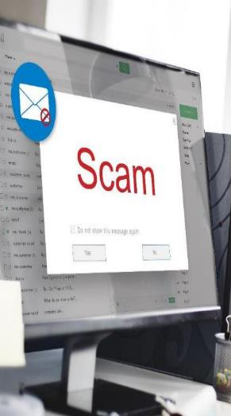
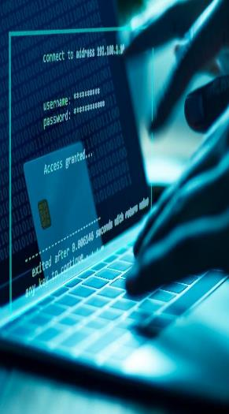
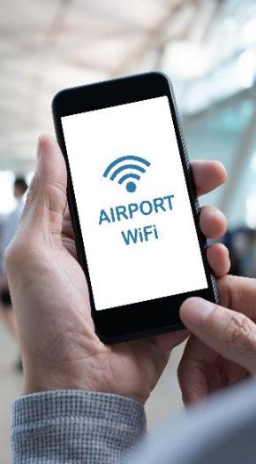
Types of Digital Threats
How to spot and avoid scams
Emails
Compromised websites
Public Wi-Fi
Text messages
Notes:
Some common digital threats include emails, compromised websites, public Wi-Fi and text messages.

Slide 11
Email Scams
Can you spot the difference?
CUSTOMERSERVICE@AMAZON.COM
CUSTOMERSERVICE@AMAZ0N.COM
There is a zero instead of an O in the word Amazon in the second email address
customercomplaintdepartment@apple.com
customercompliantdepartment@apple.com
Transposed the I and the A in the second email
returndepartment@WaImart.com
returndepartment@Walmart.com
In the first email, there is an uppercase I instead of an L in the word Walmart
This example is for illustrative purposes only. MFS is not affiliated with the websites above. These entities/products/links are being provided as a convenience and for informational purposes only; they do not constitute an endorsement or approval by MFS.®
Notes:
For emails, let’s see if you can spot the fake email addresses. I used some common scamming techniques to spoof these email addresses. Can you tell which is the fake?
Example 1…
-CUSTOMERSERVICE@AMAZON.COM
-CUSTOMERSERVICE@AMAZ0N.COM
There is a zero instead of an O in the word Amazon in the second email address
Example 2…
-customercomplaintdepartment@apple.com
-customercompliantdepartment@apple.com
Transposed the I and the A in the second email address
Example 3…
-returndepartment@WaImart.com
-returndepartment@Walmart.com
There is an uppercase I instead of a lower case L in the word Walmart in the first email address

Slide 12
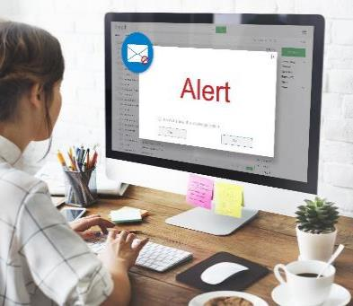
Email Scams
THREATS
PROTECTION
Fake invoice
Advance fee scam
“Suspicious” activity or “deactivated” accounts
Survey scams
“Free” trials or gift offers
Foreign money exchange scams
Verify sender address
Check email on a computer
Scan suspicious links and attachments
MFS® does not provide cyber security advice. The information contained within this material is for awareness purposes only, given the rapid pace of change in technology, the digital world and cyber threats. Third-party websites and applications are not affiliated with MFS, and MFS is not responsible for their content or content changes or for any negative effect of software installations on clients’ devices, misuse of data collected by any third-party services, or changes in the quality of services.
Notes:
Some common email scams are listed on the slide. To better protect yourself from email threats, industry best practices suggest that you… Think before you click. Don't immediately open attachments and links. Pause and make sure you know the sender. Another tip is to use a computer to check your email. It’s easier to spot some of the common scamming techniques on a computer versus your smartphone or tablet because of the larger screen. (ex: using two lower case Ns instead of a lower case M, transposing letters in the middle of a word, substituting a zero for the letter O, etc). Note: avoid using the “unsubscribe” button for unwanted emails. It could be used to redirect you to a malicious site or to verify that your email address is active. It is better to ignore, delete, and mark as spam.
When in doubt scan suspicious links and attachments.

Slide 13
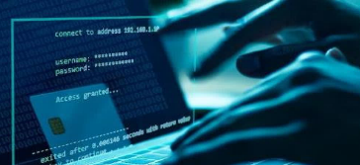
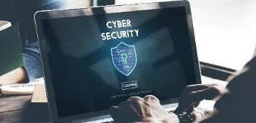
Malicious Websites
POTENTIAL RED FLAGS
PROTECTION
Misspellings in the URL
Newly created sites
Alerts or pop-ups
Grammar, spelling, and punctation mistakes
Missing contact information
Use trusted, secured network for sensitive browsing
Scan website for viruses
MFS® does not provide cyber security advice. The information contained within this material is for awareness purposes only, given the rapid pace of change in technology, the digital world and cyber threats. Third-party websites and applications are not affiliated with MFS, and MFS is not responsible for their content or content changes or for any negative effect of software installations on clients’ devices, misuse of data collected by any third-party services, or changes in the quality of services.
Notes:
For compromised websites… potential red flags are listed on the slide. To better protect yourself, industry best practices suggest to only do sensitive browsing, like banking and shopping on a personal device and trusted, secured network. In addition, you can scan websites for viruses.
Recent trend: cybercriminals have been using and altering QR codes to steal information and money from people. Use the above (and following) information to avoid becoming a victim (verify URL, be cautious when entering sensitive information after scanning a code and consider manually entering the URL).

Slide 14




Public Wi-Fi Threats
COMMON LOCATIONS
PROTECTION
Do not access personal or financial information
Use a virtual private network (VPN) app
Notes:
Next digital threat: Public Wi-Fi. When you connect to an unsecured network, your traffic can be seen by others, and in some instances, the contents of your device can be seen as well. Networks providing access can act as a middleman and intercept your communications. Airports, hotels and coffee shops are common locations for Wi-Fi threats, with free access designed to capture traffic and even drop malware on unsuspected users. Instead opt for password protected networks or use your mobile data (as it is usually encrypted).
That being said, when using public Wi-Fi, industry best practices suggest:
Do not access personal or financial information.
Consider using a Virtual Private Network (VPN) app. The VPN creates an encrypted tunnel between you and a remote server operated by a VPN service. All your Internet traffic is routed through this tunnel, so your data is secure from prying eyes. Because your traffic is exiting the VPN server, your computer or device appears to have the same IP address as the server, which helps mask your identity and location. Some VPN services include: Private Internet Access, Proton VPN, Norton Secure VPN and Express VPN. (Prices vary: Some are free or offer free-trial periods, while most have a monthly fee ranging anywhere from around $5 to $30)

Slide 15


Create strong, unique passwords
Text Scams
THREATS
PROTECTION
MESSSAGES
now
Check for ability to filter and block unknown and unwanted texts
  Ctia.org
Use common sense
Initiate the interaction yourself
John P.
Hey its John, got a new phone. I hate to bother you but im out of town and just got into a car accident. Im ok but im at hospital and need $200 to get back home.
MESSSAGES
12:30pm
Apple
Hello. We detected fraudulent activity on your Apple iCloud account. To reset password:
MESSSAGES
3:34pm
Google
Congratulations! You’ve won a $1,000 Google Play gift card. Go to
This example is for illustrative purpose only.
MFS is not affiliated with donotcall.gov. These entities/products/links are being provided as a convenience and for informational purposes only; they do not constitute an endorsement or approval by MFS.®
Notes:
Final threat: text messages. I saved this one for last because this is what experts in the security and IT world think is going to be big in the coming years. So be on the lookout for texts with links or requests for money, especially in the form of gift cards.
Industry best practices suggest that you do three things to better protect yourself.
#1, Check to see if your phone can filter and block unknown and unwanted text messages. Go to ctia.org to see if your wireless provider has a tool or service that can block unwanted text messages and for apps that may be able to do something similar.
#2 use common sense. When you get a text think about what information the person is asking for and where they want you to send it. Ask yourself, is it “normal” for them to contact you in this manner? The general rule is that legitimate companies/entities (IRS, SSA, FBI) will not ask you for account or sensitive information via text.
#3 Initiate the contact yourself. Don’t call the number, click the link or rely only on the information in the text. Contact the company using a phone number or website that you know is legitimate. Just like with scam calls… independently verify it through another source.

Slide 16
Prevention Tips
Notes:
So that's what to be on the lookout for and how to play defense against it. Now let's turn those tables, and talk about some proactive things you can do to better protect yourself. Let’s go through 5 prevention tips.

Slide 17
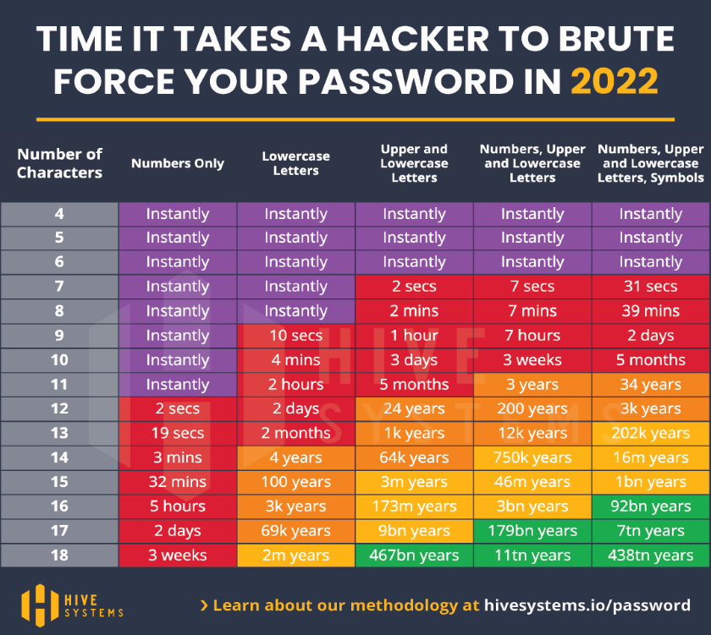
Create Strong, Unique Passwords
MFS is not affiliated with the entities above. These entities/products/links are being provided as a convenience and for informational purposes only; they do not constitute an endorsement or approval by MFS.®
Source: hivesystems.io/password-table
Notes:
According to industry experts, one of the best things you can do is create strong, unique passwords. This chart shows how quickly hackers can guess different length and character passwords. (For interactive examples go to: passwordmonster.com). To create strong, unique passwords consider doing the following:
The longer the password and more variety of numbers, letters and symbols, the harder it is to crack. Use at least 12 characters.¹
Have unique passwords for each login/account. Don’t use the same username/password combination for everything.
Set up two-factor or multifactor authentication if available. Never share those codes/PINs with anyone. Trend: callers pretending to be your bank, telling you that they are going to send you a code to validate your identity, so you need to confirm that number once you receive it. When in reality, they already have your username and/or password and are trying to log into your account. Giving them your PIN gets them that access. (Note: if they just have your username, they can use the “Forgot my password” reset option to enter the PIN, set a new password and gain access).
Consider using a password manager. A password manager can help you generate, store, and update passwords. Many password managers use “zero knowledge” architectures – meaning passwords are stored in encrypted vaults that only the end-user can access. Therefore, if a breach occurs, your information is not compromised. Some popular apps are Dashlane, 1Password, Keeper, KeePass and LastPass. (Note: August 2022, security breach at LastPass – portions of their source code and some proprietary technical information were stolen. Customer data, including passwords, were not²).
¹Protect Your Personal Information and Data, Federal Trade Commission, May 2021
²LastPass Hacked: Password Manager With 25 Million Users Confirms Breach, Forbes, August 2022
Image Source: Are Your Passwords in the Green?, Hive Systems, March 2022.

Slide 18

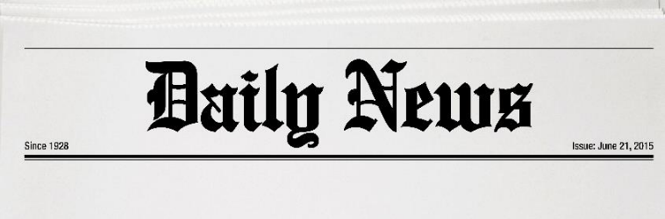
Back Up Information and Update Software
Baltimore Estimates Cost of Ransomware Attack at $18.2 Million As Government Begins to Restore Email Accounts
COLONIAL PIPELINE PAID $5 MILLION RANSOM TO HACKERS
- cnbc.com
Sources: “Colonial Pipeline paid $5 million ransom to hackers,” cnbc.com, May 2021
"Baltimore estimates cost of ransomware attack at $18.2 million as government begins to restore email accounts," The Baltimore Sun, May 2019
Notes:
The second thing you can do is back up your information and update operating software.¹
Industry experts suggest backing up your information regularly to an encrypted device or format on a device. That way if your computer or phone is stolen, hacked or hijacked, you won't be forced to pay a ransom to get it back. You have a copy of it. You can back it up to the cloud (ex. iCloud or GoogleDrive). Or you can back it up with an external hard drive or USB. Use encryption for sensitive data so that only you and authorized users can see it. And for your really important information, consider keeping an additional hard copies in a safe.
They also suggest making sure that your software is up to date, including your operating system, web browsers, and apps. ¹ If a vulnerability is discovered in existing software, updates may be released to correct it. Most of these updates can be set to occur automatically, so double check that yours is set up this way.
Cyber hijacks have made headlines over the past couple years, as companies, municipalities and entities have been attacked. Hackers hijack their systems then blackmail them to get their data back. Example of a company that decided to pay the ransom: Colonial pipeline. Cost = $5million. Example of an entity that did not pay the ransom: city of Baltimore. In 2018, Baltimore’s computer systems were hacked. Scammers demanded a ransom in bitcoins worth about $76,000. The city refused to pay. In the end, it cost Baltimore an estimated $18.2millon to fix it. Because some people have paid ransoms to get their information back, it is anticipated that we will see more of these attacks going forward.
But please note, the FBI does not recommend that people pay the ransom. Paying a ransom in response to a ransomware attack does not guarantee you/your organization will get any data or information back nor does it ensure protection from future breaches². In addition, it may incentivize scammers to try more attacks in the future. If you are a victim of ransomware the FBI suggests that you²
Contact your local FBI field office to request assistance or submit a tip online.
File a report with the FBI’s Internet Crime Complaint Center (IC3).
Source Headline: “Colonial Pipeline paid $5 million ransom to hackers”, CNBC, May 2021
Source: "Baltimore estimates cost of ransomware attack at $18.2 million as government begins to restore email accounts," The Baltimore Sun, May 2019
¹Source: Protect Your Personal Information and Data, Federal Trade Commission, May 2021
²Source: Scams and Safety, FBI 2021

Slide 19
Review and Monitor Financial Statements
Under federal law, each credit bureau is required to provide consumers
one free report
each year
AnnualCreditReport.com
1-877-322-8228
Three major credit bureau websites that provides credit reports:
Equifax.com
Experian.com
Transunion.com
Source: Consumer Financial Protection Bureau; “List of consumer reporting companies.”consumerfinance.gov/consumer-tools/credit-reports-and-scores/consumer-reporting-companies, Site accessed March 10, 2021.
Consumer Financial Protection Bureau; ”List of Consumer Reporting Companies,” 2021. files.consumerfinance.gov/f/documents/cfpb_consumer-reporting-companies-list_2021.pdf Site accessed March 10, 2021.
MFS is not affiliated with the entities above. These entities/products/links are being provided as a convenience and for informational purposes only; they do not constitute an endorsement or approval by MFS.®
Notes:
(Compliance Note: Slide from “Figuring out your number” presentation - 45119)
The third thing you can do is review and monitor all financial statements, especially your credit reports. As those are the ones that tend to slip through the cracks and can oftentimes, be one of the first indicators that you're a victim of identity theft or that someone's been using your data and information.
The three major credit bureaus are Equifax, Experian and TransUnion. Under federal law, each credit bureau is required to provide consumers with one free credit report each year. One place to request yours is: annualcreditreport.com. Now most people know to do this for themselves, but what’s not as well known is that you should also do this for your children, even those under 18. Criminals can have a field day with a child’s information because it’s never been used before. And because most people don’t check their child’s credit report, they can go undetected for years. To request your child’s credit report:
If your child is 14 or older, go to annualcreditreport.com.
If your child is 13 or younger, you will most likely need to fill out paperwork to prove you have the right to this information. The website has detailed information about how to do this.
If want to take it a step beyond monitoring, you could consider freezing your credit or your child's credit. It closes that file off to new credit. This won't protect you from all types of fraud, but it could help. To place a security freeze, you need to contact each of the three credit bureaus: Equifax, Experian and TransUnion. Another option is to place a free “fraud alert” with the credit bureaus. If you place the alert at one of the three bureaus, it will automatically carry over to the other two. A regular fraud alert lasts 1 year, an extended one lasts 7 (available for people that have had their identity stolen).
Finally, you should consider setting up “account alerts” for your bank, credit card and other financial accounts, if available. The alerts usually come in the form of a text message or email notifying you of a transaction in the account. In most cases, the alerts don’t cost anything to establish and are customizable so you can select when you want to notified (Ex: notification of withdrawals, not deposits; notification only if above a certain dollar amount).

Slide 20
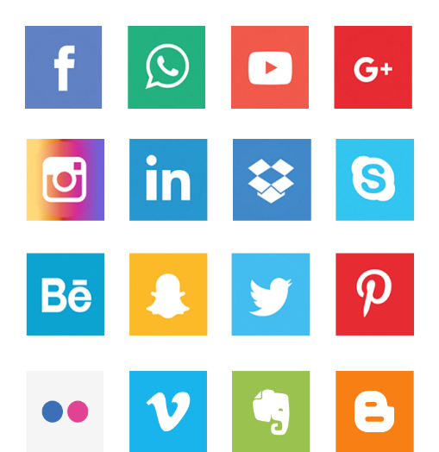
Be Mindful With Web Activity
Use personal device and trusted, secured network
SOCIAL MEDIA SECURITY
Keep accounts private and review connections
Be wary when sharing personal information
Check app settings
MFS is not affiliated with Facebook, WhatsApp, YouTube, Google+, Instagram, LinkedIn, Dropbox, Skype, Behave, Snapchat, Twitter, Pinterest, Flickr, Venmo, Evernote, and Blogger. These entities/products/links are being provided as a convenience and for informational purposes only; they do not constitute an endorsement or approval by MFS.®
Notes:
Fourth, be mindful with web activity. As we discussed earlier, you want to do sensitive browsing, like banking and shopping, on a personal device and a trusted, secured network. And avoid using public Wi-Fi whenever possible or, if you have to, be sure to use a VPN.
But what I really want to discuss with this one is social media. A surprising amount of data can be gained from connecting, following or friending someone. Think about it… where you grew up, where you live, who your relatives are, your pet's name, where you went to school, or if you're on vacation. Scammers can use this information against you to do things like guess passwords, answer security questions and create profiles. So try to limit the information that you share on social media. Best security practices for social media include:
Keep accounts private and only connect, friends and follow people you know.
Remove personal information from your profiles and posts wherever possible. Don’t share anything you wouldn’t tell a friend or acquaintance.
Be aware of the automatic settings for apps. You want to go through your security settings to make sure you’re comfortable with what each app has access to. They could be set to automatically have access to things like your camera, microphone, location, pictures, phone storage, folders and contacts. Sometimes this may make sense. Other times, it may not. The point is that you should be aware of this, so you can decide what you’re comfortable with.
Finally, talk about these best practices with your family members, especially your children. Social media is now a part of people’s everyday lives. Kids may not realize that they shouldn’t post addresses and telephone numbers, that they shouldn’t check-in wherever they go – they may not see the danger. It’s important to talk about what kinds of information shouldn’t be shared and why.

Slide 21



Social Media Scams
Common threats and how to spot them
INVESTMENT SCAMS
ONLINE SHOPPING SCAMS
ROMANCE SCAMS
Potential signs of a scam:
Statements of “guaranteed returns” with “no risk”
Advertised investments include cryptocurrencies and real estate
Fake testimonials, often from celebrities
Potential signs of a scam:
Check for contact information on the website
Search company name or product with words like “fake” or “scam” to see what others say
Potential signs of a scam:
Professes love quickly
Living or traveling outside the country for business
Asks for money
Cancels visits due to emergencies

Slide 22
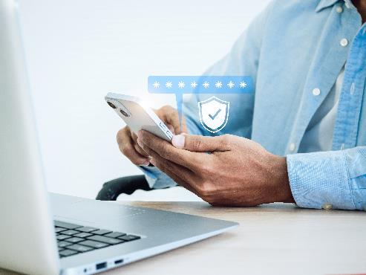
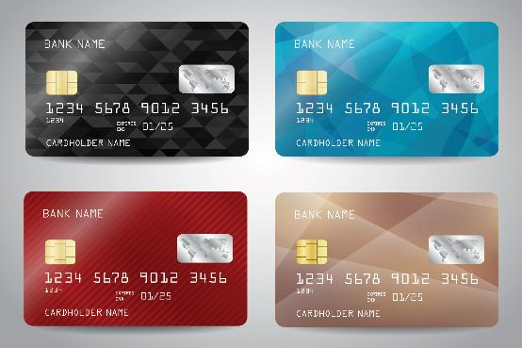
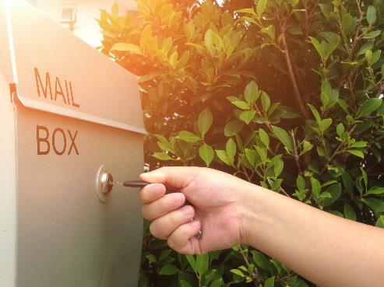
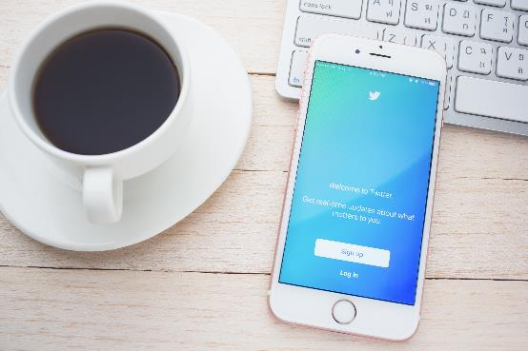
Always Initiate the Interaction Yourself
Trust but verify
Notes:
And finally: Always initiate the interaction yourself. You want to be the one starting the contact. Double check it and make sure that contact information matches what you have or what you find online. Try to independently validate these things.

Slide 23
Actions to Take If Scammed
Notes:
Now, unfortunately, in the data-driven world we live in, even if you follow all these tips and rules, you can still become a victim. So let’s talk about what you can do if you become a victim.

Slide 24
Steps to Take if You Are a Victim
Act fast!
What to do if you paid with a…
What to do if they obtained sensitive info
  Credit or debit card
  Money transfer app
  Check
  Wire transfer
  Gift card, prepaid card or cash reload card
  Cryptocurrency
  Your username and password
  Remote access to your computer
  Your Social Security number
Report scams to the Federal Trade Commission at ftc.gov and/or to the Federal Bureau of Investigation at Ic3.gov
Notes:
The best thing you can do is to act fast. The sooner, the better. And what you should do depends on what the scammers stole: money or information.
If they stole money, your best chance to recover it depends on how quickly you react and how you paid them. If you paid with.
A credit or debit card: You may be able to stop the transaction. Contact your credit card company or bank right away. Tell them what happened and ask them to reverse the charges. This is much more likely to happen if you paid with a credit card rather than a debit card, but it is still worth trying either way.
A money transfer app: Like Venmo. Contact the company and see if they can reverse the payment. In many cases, after you send the money, it's gone. A sender will have a hard time getting the money back without the other person's consent. If the app is linked to a credit card or debit card, try to contact them to see if they can help. But watch out for a scam. If someone calls and offers to “help” you recover money you have already lost, don’t give them money or personal information. You’re probably dealing with a fake refund scam. Remember, you always want to initiate the contact.
A check: If it hasn't been deposited, contact your bank to cancel it. If it has been deposited, the money is likely gone. Either way, they have your routing and bank account number, so you should freeze that account.
Wire transfer: Call your bank or the money transfer company immediately. Ask them to reverse the wire transfer. While it’s unlikely they will, as wires are essentially the same thing as sending case, but it’s important to ask.
Gift card, prepaid card, or cash reload card: Contact the company that issued the card right away. Tell them you paid a scammer with the card and ask them to refund your money. Gift cards are becoming an increasingly popular way for scammers to steal money. Popular ones include iTunes, Google Play and Amazon. A red flag is if someone asks for a gift card number and PIN. That’s all a scammer needs to have access to that money immediately.
Cryptocurrency: Contact the company that you used to send the money and ask them to reverse it. In general, crypto transfers cannot be reversed. So once the money is gone, it is nearly impossible to get back. According to the FTC, since the start of 2021, more than 46,000 people have reported losing over $1 billion in crypto to scams¹. A legitimate business will never demand that you buy or pay with cryptocurrency.
If they stole sensitive information, some immediate action steps to take if they got:
Your username and/or password: Change your password right away (may have to contact company to do this). If you use the same password for other accounts or sites, change those too.
Remote access to your computer: You’ll want to update your computer’s security software, then run a scan. Delete anything it identifies as a problem. To make sure everything is gone, consider wiping the system completely, or even consulting with experts (like the GeekSquad) to ensure that there are no traces of malware or back doors left behind.
Social Security Number (SSN): Go to identitytheft.gov. You can report what happened, they'll tell you what to look for on your credit report and they'll create a personal recovery plan for you. It's unlikely that they'll issue you a new number. Plus issuing a new number doesn't solve all your problems, because there are still records of your old one. So a new number doesn't mean a fresh start. You’ll also want to file a complaint with your local police department and report it to the Internet Crime Complaint Center (IC3), which is part of the FBI. Having these reports on hand can go a long way in helping you prove that your identity theft claims are legitimate when disputing credit reporting errors and fraudulent charges. You also may want to contact the IRS and the Social Security Administration, because if a scammer has your Social Security Number (SSN), they can file a tax return to steal your refund. Start with identitytheft.gov; they’ll walk you through the steps.
Most scams can be reported to the FTC at ftc.gov (direct site: ReportFraud.ftc.gov). Internet and international scams, specifically, can be reported to the FBI at ic3.gov. Reporting scams can help these agencies identify trends, build cases, and stop criminals.
¹Source - Reported crypto scam losses since 2021 top $1 billion, says FTC Data Spotlight | Federal Trade Commission

Slide 25
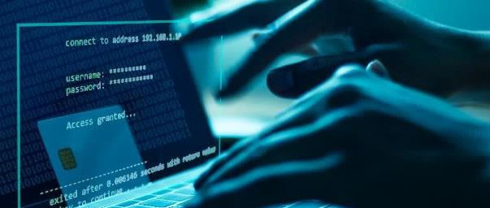

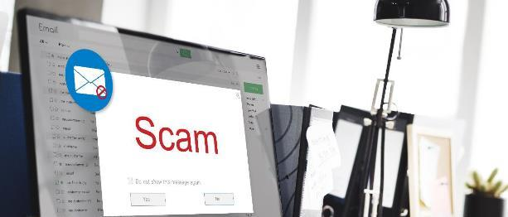
Key Takeaways
Types of threats and attacks
Prevention tips and ways
to fight back
Actions to take if scammed
Direct
Digital
Hybrid
Strong unique passwords
Back up information and update software
Review and monitor financial statements
Be mindful with web activity
Always initiate the interaction yourself
Act fast
Notes:
Now I know that we've gone over a lot today. We've talked about recent scams, prevention tips and what to do if you become a victim. Our hope is that you’re now more aware of the types of threats and attacks that are out there and that you’re leaving here with a few things that may help you better protect yourself and your loved ones. Thank you.

Slide 26
Resources to Keep In Mind
DIRECT
DIGITAL
PREVENTION
Optoutprescreen.com
Dmachoice.org
Catalogchoice.org
Informeddelivery.usps.com
Donotcall.gov
Ctia.org
Ctia.org
Check URLs
Scan links, attachment, & websites
VPN service
Password manager
Annualcreditreport.com
If a victim:
Identitytheft.gov
ReportFraud.ftc.gov
Ic3.gov
MFS® does not provide cyber security advice. The information contained within this material is for awareness purposes only, given the rapid pace of change in technology, the digital world and cyber threats. Third-party websites and applications are not affiliated with MFS, and MFS is not responsible for their content or content changes or for any negative effect of software installations on clients’ devices, misuse of data collected by any third-party services, or changes in the quality of services.
Notes:
(Note to speaker: This slide is meant for you use as a visual during the Q&A session. People usually request this information be repeated.)

Slide 27
Thank You!

Slide 28
Additional slides

Slide 29
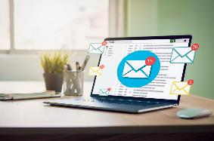
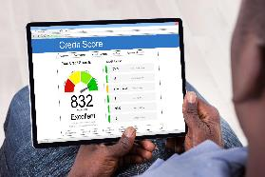





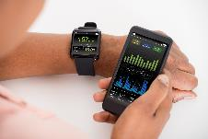
Are You Already a Victim?
There have been many large-scale data breaches
3B
ACCOUNTS
148M
ACCOUNTS
360M
ACCOUNTS
500M
ACCOUNTS
533M
ACOUNTS
153M
ACCOUNTS
700M
ACCOUNTS
150M
ACCOUNTS
MFS® is not affiliated with the entities above. These entities/products/links are being provided as a convenience and for informational purposes only; they do not constitute the approval or endorsement of MFS.
Sources: The 15 biggest data breaches of the 21st century," CSO, July 2021. "Equifax Data Breach Settlement," Federal Trade Commission, January 2020.
Notes:
Below are some of the biggest data breaches in terms of impact:
Yahoo – 3 billion accounts – the company was hacked in 2013, although it wasn’t revealed until 2016. Attackers were able to access account information like security questions and answers. Plaintext passwords, payment card and bank data were reportedly not stolen. In 2014, Yahoo suffered a second attack which impacted 500 million accounts. In this case sensitive information like names, emails addresses, phone numbers, hashed passwords and dates of birth were stolen.
LinkedIn – 700 million users – in June 2021, a hacker posted data associated with 700 million LinkedIn users. LinkedIn reported that no sensitive, private data was stolen, however email addresses, phone numbers, geolocation records, genders and other social media details were exposed.
Facebook – 533 millions users – in 2019, information, including account names, phone numbers and Facebook IDs, from over 530 million users was exposed online.
Marriott International (Starwood) – in 2018, Hotel Marriot International suffered an attack which exposed sensation information belonging to over 500 million customers. This included names, mailing addresses, phone numbers, email addresses, passport numbers, Starwood Preferred Guest account information, dates of birth, and gender, in addition to other information.
MySpace – 360 million user accounts – in 2016, 360 million MySpace user accounts were exposed online. MySpace dated the attack back to 2013 and said the lost data included email addresses, passwords and usernames.
Adobe – 153 million user records – in 2013, information from 153 million Adobe users was exposed. This include customer names, passwords, and debt/credit card information.
My Fitness Pal – In 2018, My Fitness Pal, which is owned by Under Armour, exposed information from 150 million user accounts. This included email addresses, IP addresses, usernames and passwords.
Equifax – In 2017, Equifax revealed a data breach. The private records of over 148 million people were exposed. This information included names, SSN, dates of birth and addresses.
Source: csoonline.com/article/2130877/the-biggest-data-breaches-of-the-21st-century.html
Source for Equifax: epic.org/privacy/data-breach/equifax/
Potential new source as it lists all these breaches: The 65 Biggest Data Breaches (Updated June 2022) | UpGuard

Slide 30
Threats by Generation
Gen Z*
Scams related to scholarships and grants for school, QR codes, employment opportunities, apartment listings and social media
Millennials*
Scams related to student loan and debt forgiveness, online shopping, business opportunities and text messages
Gen X*
Scams related to online relationships, parcel tracking, investment opportunities and emails
Boomers and Older*
Scams related to computer technical support, sweepstakes and lotteries, impersonators and phone calls
*According to PEW Research Center: Gen Z refers to the generation born after 1996, Millennials refers to the generation born 1981 to 1996, Gen X refers to the generation born 1965 to 1980, Boomers refers to the generation born 1946 to 1964.
Notes:
Now, before we get into what we will talk about, let’s make it clear what this presentation is NOT.
It is not a vocabulary lesson. We’re not going to worry about the difference between ransomware and malware, spamming or spoofing. We’re focused on threats and attacks.
It is not meant for one segment of the population. Scammers target people of all demographics.
And, it’s not meant to scare you. We want to empower you with information and knowledge so you can make the best cyber security decisions for yourself and your family.
The good news is that you're probably already taking some steps to protect yourself, and hopefully after this session you can take even more steps to increase your resiliency against these types of attacks. After all, you can't protect yourself if you don’t know what to look for.
Protecting your Data: Aware and Prepared Brochure (46424)

Slide 31
Prevention Tips and Ways to Fight Back
The best defense is a good offense
Create strong, unique passwords
Back up information and update software
Review and monitor financial statements
Be mindful with web activity
Always initiate the interaction
Notes:
Visual with the top-five prevention tips and ways to fight back (including slide in case speaker doesn’t have time to cover all 5 tips – gives them the flexibility to discuss 2 or 3 if needed)

Slide 32
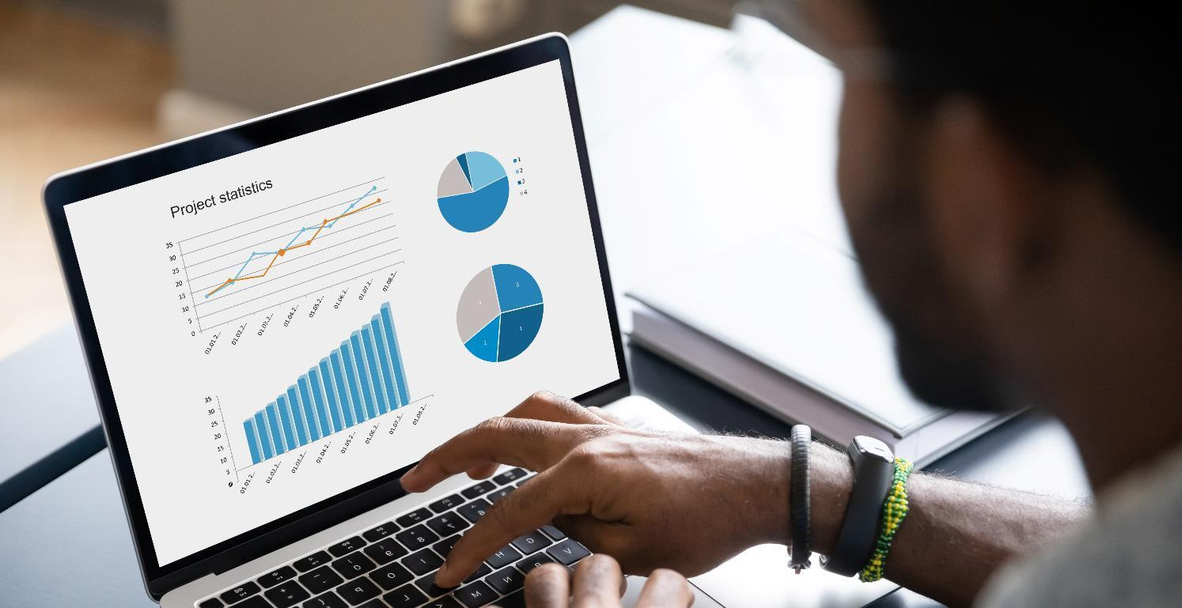
Scam “Questionnaires” and “Quizzes”
Hackers can use these to steal personal information
  What’s your mother’s maiden name?
  What street did you grow up on?
  What was the name of your first pet?
  What’s your favorite number?
Notes:
Watch out for questionnaires/quizzes through social media, apps and video games, which can be used to mine data about you. These innocent looking games and posts are common tactics used by scammers to collect information to essentially create a hacking dictionary for you. Kids and young adults can be especially vulnerable to these attacks because they are often disguised as fun games or innocent posts.
Quizzes like “Which ____ are you?” where you answer a series of questions to determine the answer. Examples include: Which Disney princess are you? Which Dr. Seuss character are you? Which Hogwarts house do you belong in?
Red flag = Month and Date games. That information is very useful data to collect when trying to steal someone's identity. Ex: “What’s your elf name?” Determined by birth month and day. The post encourages people to share/comment their name which scammers can use to determine their birth date.
Posts like an image of a cool-looking car, asking for the make and model of the car you learned to drive on. Or an image of a band, asking what the first concert you went to was and how old you were.
Examples of questions:
What’s your mother’s maiden name?
Where were you born?
What street did you grow up on?
What was your high school mascot?
What’s the name of your childhood best friend?
What was the name of your first pet?
What was your first job?
What was your first car?
What’s your favorite number?
What’s your favorite color?
What’s your favorite sports team?

